Slide 1

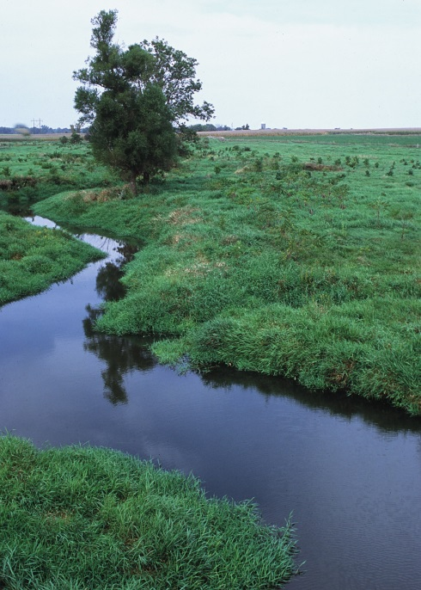
Regional Conservation Partnership Program
Idaho
Compiled by J. Howard Johnson – District Conservationist

Slide 2

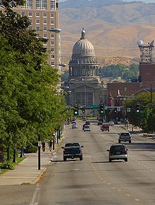
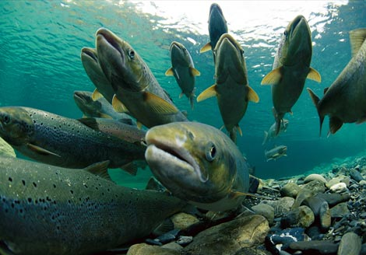
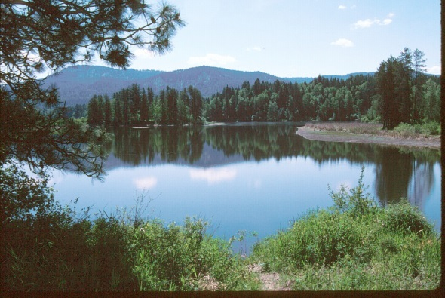

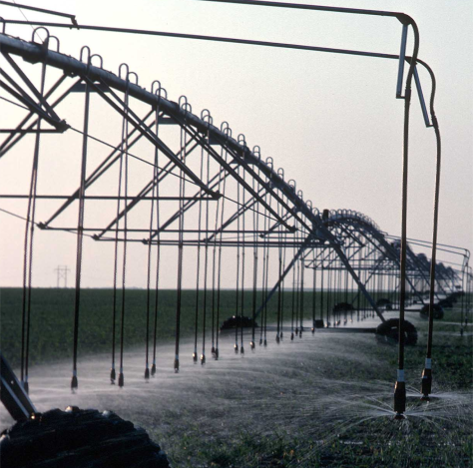
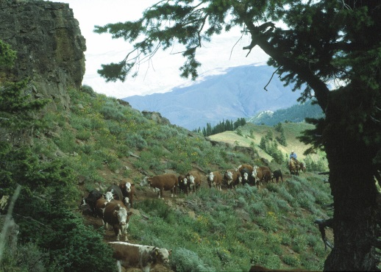
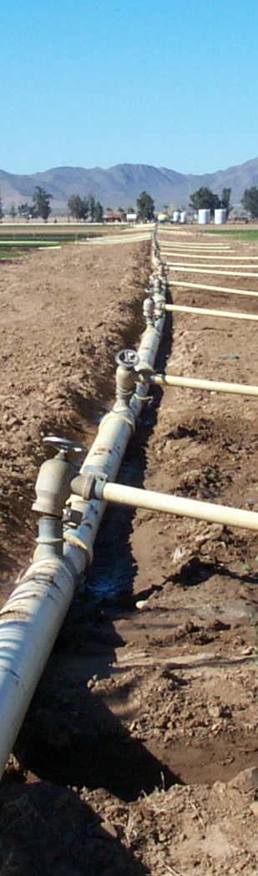

Slide 3
Vision
RCPP offers opportunities for NRCS to work with partners to encourage:
locally driven innovation
create solutions
accelerate the conservation mission
launch bold ideas
demonstrate the value and efficacy of voluntary, private lands conservation

Slide 4
Measures of Success
NRCS will measure environmental successes through the following four criteria:
Solutions
Contributions
Innovation
Participation

Slide 5
Measures of Success
1. Solutions – NRCS will invest in projects that generate near-term results that are measurable from environmental, economic, and social perspectives. Both partners and NRCS staff will be involved with documenting the outcomes of these conservation investments.

Slide 6
Measures of Success
2. Contributions – NRCS will promote leveraging of other Federal and non-Federal resources. The agency goal is to at least double the total investment in conservation, including cash and in-kind contributions from both Federal and non-Federal sources

Slide 7
Measures of Success
3. Innovation – NRCS will select innovative projects that integrate multiple conservation approaches to deliver comprehensive and measurable solutions.

Slide 8
Measures of Success
4. Participation – NRCS will seek to maximize the number of organizations that participate in and contribute to projects

Slide 9

A new 2014 Farm Bill conservation program that:
Furthers the conservation, restoration, and sustainable use of soil, water, wildlife on a regional scale
Encourages partners to cooperate with producers
Provides assistance through:
  Partnership agreements
  Program contracts or easement agreements

Slide 10
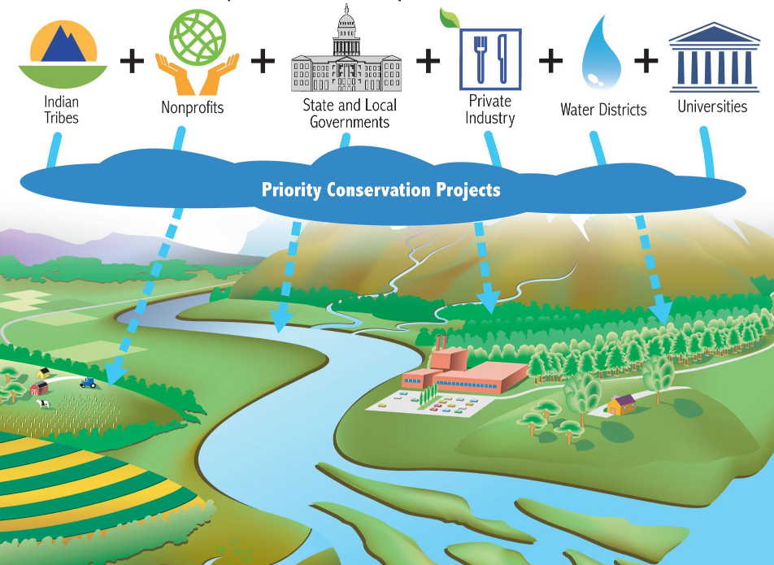
More Partners bring innovation, new ideas, resources and local expertise to solve problems

Slide 11
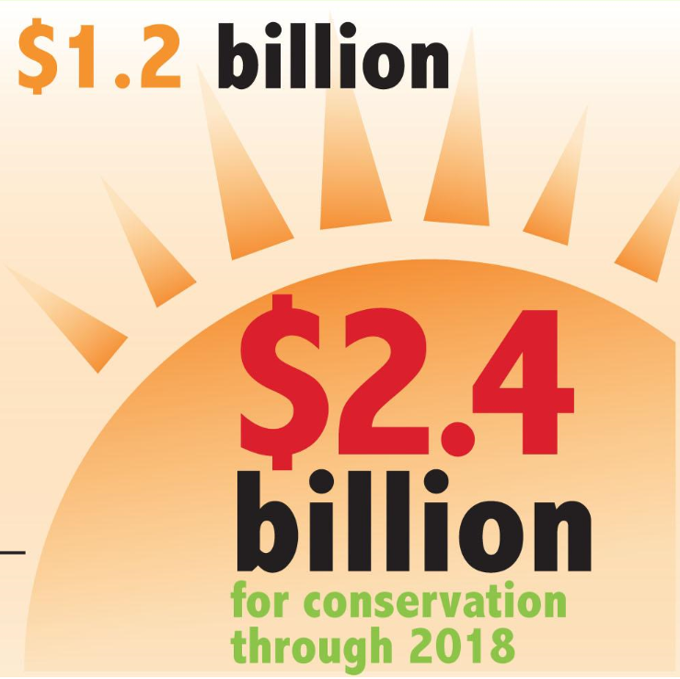
Receives funding:
$100 million each year directly from the 2014 Farm Bill
Also, by reserving 7% of funds from the four covered programs annually
Over five years, USDA plans to invest up to $1.2 billion with partners matching funding that could be as much as $2.4 billion for conservation

Slide 12
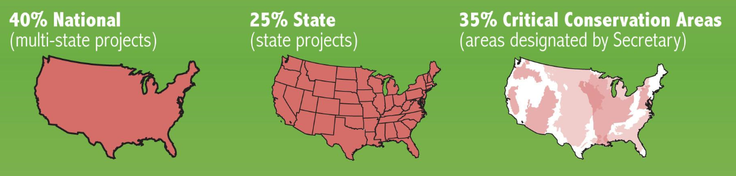
Allocates funding by:
40% for projects based on a national competitive process
25% for a state competitive process administered by STC’s
35% for projects in critical conservation areas

Slide 13
National Funding Pool
Priority will be given to multistate Projects
National priorities for FY 2014/2015
Water quantity
Water quality
Soil health
At risk species habitat
Air quality

Slide 14
Allows the Secretary to establish Critical Conservation Areas:
Up to 8 areas
Give priority to areas:
  With significant agricultural production
  Benefiting from water quality or quantity improvement
  Containing landowners and producers that need to meet or avoid negatively impacting regulations

Slide 15
Critical Conservation Areas
Great Lakes Region (IL, IN, MI, MN, NY, PA,OH, WI)
Chesapeake Bay Watershed (DE, MD, NY, PA, VA,WV)
Mississippi River Basin (AR, KY, IA, IL, IN, LA, MN, MS, OH, SD,TN, WI)
Longleaf Pine Range (AL, FL, GA, LA, MS, NC, SC, TX,VA)
Columbia River Basin (ID, OR, WA)
California Bay Delta (CA)
Prairie Grasslands Region (CO, KS, IA,MO, MN, MT, ND, NE, NM, SD, TX, WY)
Colorado River Basin (AZ, CA,CO, NM, NV, UT, WY)

Slide 16
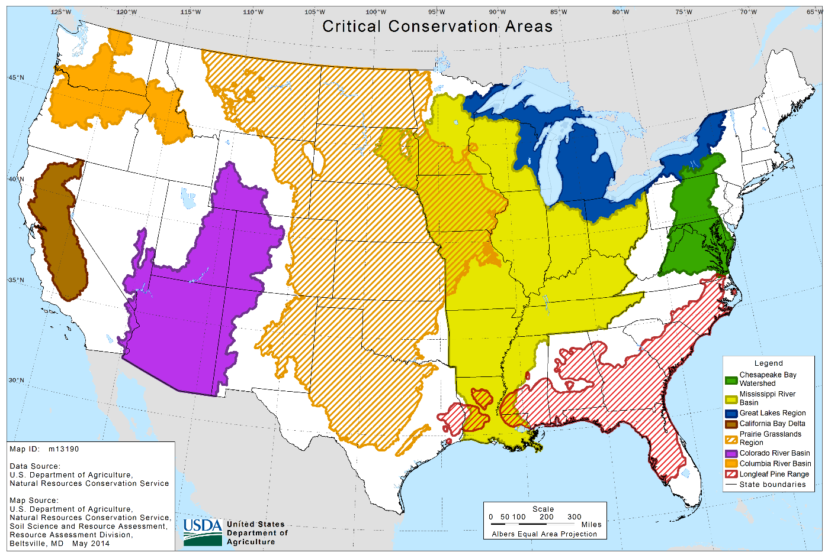

Slide 17
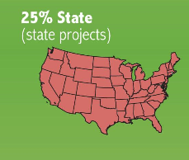
Priority Resource Concerns for Idaho
Soil Health/Soil Erosion
Species of Concern – Wetland/Upland
Water Quantity
Water Quality
Forestland Health
Rangeland Health

Slide 18
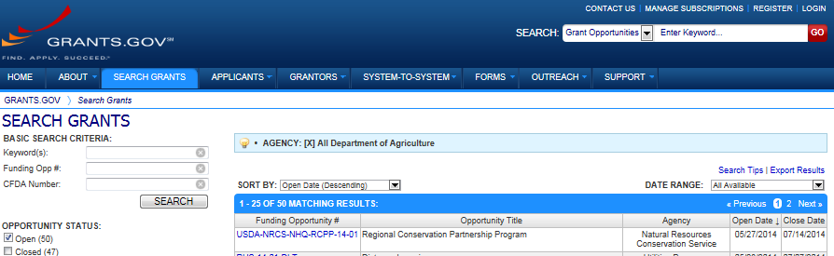
NRCS is now accepting proposals for RCPP
The announcement for program funding can be found on grants.gov. More information on the program can be found at nrcs.usda.gov
Pre-proposals are due July 14, and full proposals are due September 26

Slide 19
Eligible lands and partners for RCPP
Eligible land includes:
  cropland, grassland, rangeland, pastureland, nonindustrial forest land, other land incidental to agricultural production (wetlands, buffers etc.)
Eligible partners may include:
  agricultural producer associations, Forestry producer associations, groups of producers, State or units of local governments, Indian tribes, farmer cooperatives, water district, irrigation district, rural water districts, municipal water or wastewater treatment entities, conservation driven nongovernmental organizations, institutions of higher education

Slide 20
Applications
The project area does not need to be contiguous, but the geographic boundaries need to be described
The project must address at least one identified priority resource concern

Slide 21
Application Caveats …..
No funding may be used to cover partner administrative costs
The State Conservationist must provide a letter of support for the project no matter if the project proposal is submitted for the CCA, National or State funding pools during the full proposal phase of the program.

Slide 22
NRCS may give higher priority to proposals that:
Deliver high percentages of applied conservation to address conservation priorities or local, State, regional, or national conservation initiatives
Significantly leverage non-Federal financial and technical resources and coordinate with other local, State, regional, or national efforts
Provide innovation in conservation methods and delivery
Assist producers in meeting or avoiding the need for a natural resource regulatory requirement

Slide 23
Partnership Agreements:
Partnership agreements may not exceed 5 years; however, NRCS may extend the agreement 1 time for up to 12 months
The partnership agreement defines the scope of the project, including:
  Eligible activities to be implemented
  Potential agricultural or nonindustrial private forest operation affected
  Local, State, multi-State or other geographic area covered
  Planning, outreach, implementation and assessment to be conducted

Slide 24
Partners are responsible for:
Defining the scope of the project
Providing outreach and education to eligible producers for potential participation in the project
Assisting landowner’s or producer’s with NRCS applications, at their request;
Leveraging financial or technical assistance provided by NRCS with additional funds to help achieve the project objectives
Conducting and providing an assessment of the project costs and conservation effects

Slide 25
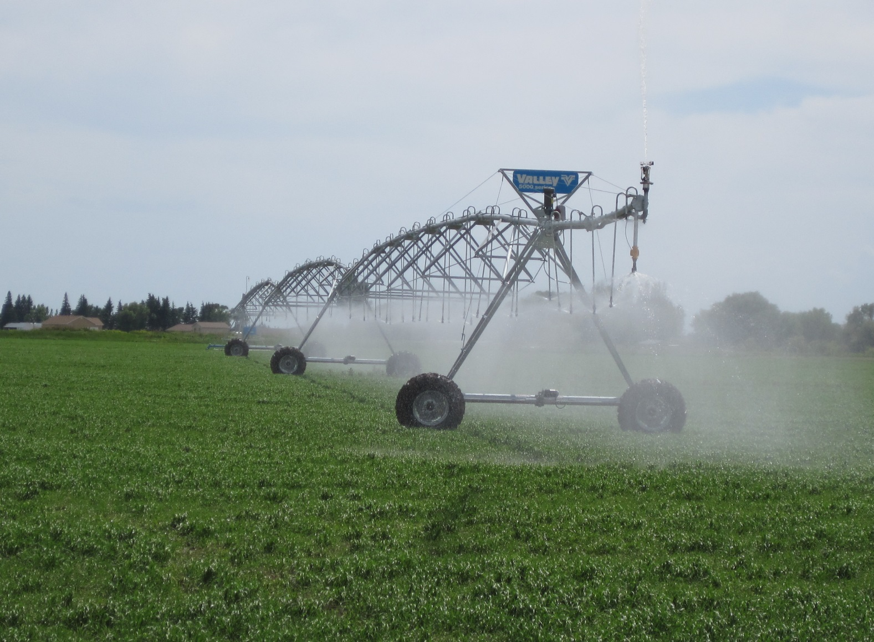
Eastern Snake Plain Aquifer RCPP

Slide 26
Eastern Snake Plain Aquifer Stabilization RCPP Project
Idaho Department of Water Resources (IDWR) submitted application for RCPP
NRCS funding in the amount of $1.1million
Purpose is to stabilize and recover groundwater levels
Sign-up deadline is November 20, 2015
All applications will be ranked by NRCS

Slide 27
Eastern Snake Plain Aquifer Stabilization Project 4 options available:
1. End gun removal and Irrigated to Dryland conversion
2. Variable Rate Irrigation (VRI)
3. Flood Irrigation Enhancement
4. Thousand Springs Conservation Projects

Slide 28
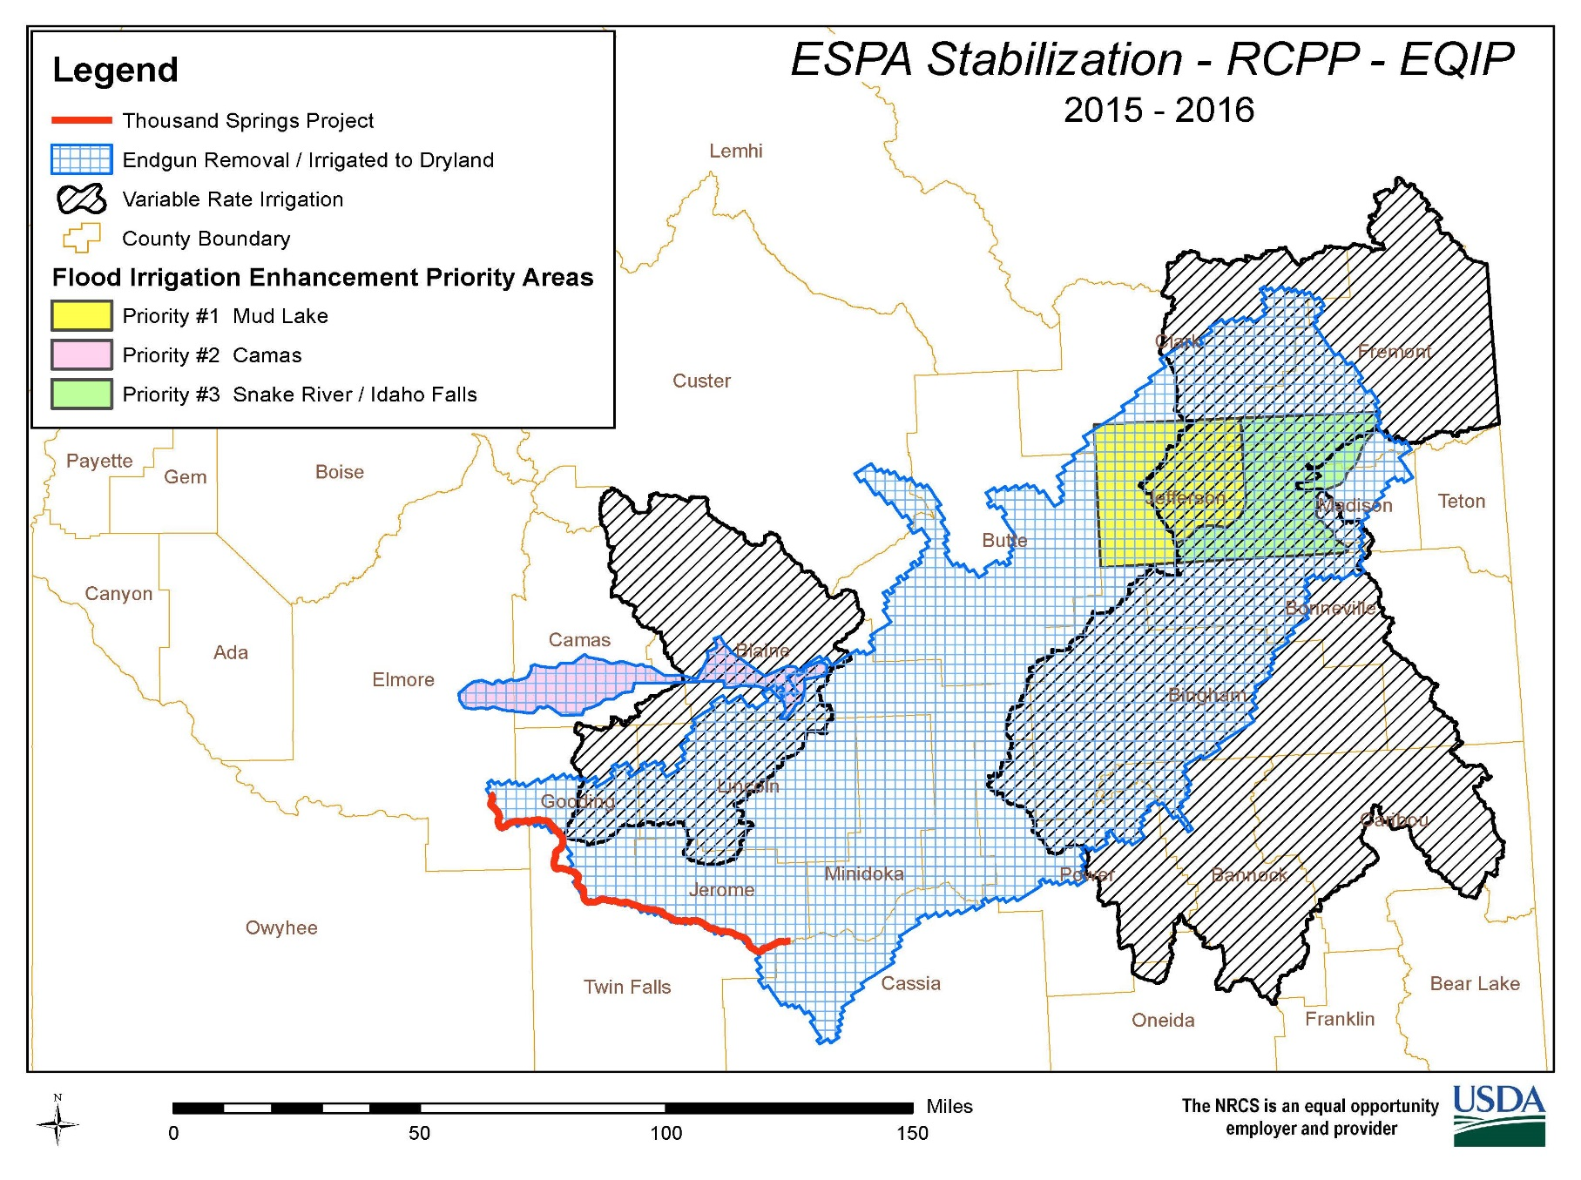

Slide 29
End-Gun Removal / Conversion to Dryland
Only available for groundwater irrigated acres
The applicant must have a water right review completed by the Idaho Department of Water Resources (IDWR)
The applicant must also sign a contract not to divert with IDWR and provide a copy of the contract to NRCS prior to obligation
Annually planted crops must make up at least one-third of the crop sequence to be eligible
No acre limits
Must establish vegetation on acres converted (alfalfa counts)
Can harvest and/or graze converted acres
Must remove end guns and/or nozzles from the irrigation system
Payment rate will be approx. $297/acre/year
Contracts will be required for 3 years

Slide 30
Variable Rate Irrigation (VRI)
Only available for groundwater irrigated acres
The applicant must have a water right review completed by the IDWR
Involves the installation of variable rate drives on pivots to allow growers to adjust rotation speeds for varying conditions
Must develop a prescription map based on topography and soil conditions

Slide 31
Flood Irrigation Enhancement
The applicant must have a water right review completed by the IDWR
Purpose is to retain and improve surface water flood irrigation systems that will increase aquifer recharge and will improve quality of wildlife habitat

Slide 32

Questions and Comments

Slide 33
Contact information:
J. Howard Johnson
NRCS Rigby Field Office
208-745-6664 ext. 101

